Slide 1
MANAGEMENT OF TYPE 1 DIABETES Module Section 2
Presented by
Kailin Rumfield, MSN, CPNP
Patricia LaSalle, MS, RD, CDE, LDN

Slide 2
Disclosure
Kailin Rumfield MSN, CRNP, CPNP
is a Pediatric Nurse Practitioner in an endocrinology practice in Allentown, PA. There are no financial relationships with commercial interest of her own, her spouse/partner, and/or immediate family member in the preceding 12 months.

Slide 3
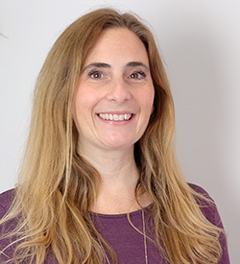
Disclosure
Patricia LaSalle MS, RDN, CDE, LDN
is a registered dietitian and certified diabetic educator as well as an Instructor in the Department of Nutrition at Cedar Crest College. There are no financial relationships with commercial interest of her own, her spouse/partner, and/or immediate family member in the preceding 12 months.

Slide 4
Objectives
Identify hyperglycemia and hypoglycemia causes, signs and symptoms and treatment with rescue agents.
Understand the therapeutic interventions including various insulin therapies and insulin regimens for patient with type 1 diabetes.
Be familiar with BG monitoring and testing options.
Provide basic understanding of insulin pump technology and continuous glucose (CGM) devices available today.
Identify multidisciplinary team members for patients with type 1 diabetes.

Slide 5
Type 1 diabetes (T1D)
Type 1 diabetes (T1D), once known as juvenile diabetes or insulin-dependent diabetes, is a chronic autoimmune condition in which the pancreas produces little or no insulin.
Insulin is a hormone needed to allow sugar (glucose) to enter cells to produce energy.
Insulin is life sustaining and the mainstay of treatment.
T1D has no cure. Treatment focuses on maintaining blood sugar levels using injectable/infused insulin, some dietary management and physical activity.
Exact cause is unknown but can be triggered by environmental conditions. Also has genetic predisposition.

Slide 6
Target Blood Glucose Levels
Age | Pre prandial | Postprandial or Bedtime | A1C
Children/ Adolescents | 90-130 mg/dL | 90-150 mg/dL (bedtime) | <7.5% <7.0 if low risk of hypoglycemia
Non-pregnant Adults | 80-130 mg/dL | <180 mg/dL (1-2 hr. pp) | < 7.0% (ADA Standards of Care , 2020)

Slide 7
Hypoglycemia: Low Blood Glucose Symptoms
Hunger
Nausea
Tremors
”Shaky”
Diaphoresis
Pallor
Headache
Confusion
Slow to respond
Hyperactivity
Slurred speech
Seizure
Loss of consciousness
(ADA, 2020)

Slide 8
Treating Low BGs (< 70 mg/dl)
Rule of 15’s
1) Give 15 grams of fast-acting carbohydrate
2) Recheck blood sugar in 15 minutes
3) Repeat treatment if blood sugar is still <100
(Evert, 2014; ADA, 2020)

Slide 9
Preventing Lows
1) Avoid delaying meals & snacks.
2) Provide snack prior to exercise activities.
3) Lower mealtime insulin dose on gym days or prior to exercise
activity such as recess.

Slide 10
Treating Lows: Fastest is Best
Fast-acting carbs: Not fast-acting carbs:
-Glucose tabs (#3-4) -Cookies
-Fruit juice (4 oz.) -Chocolate
-Soda (regular 4 oz.) -Crackers
-Jelly beans/skittles -Granola bars
-Honey/icing -Cupcakes
-Table sugar -Yogurt
-Cupcakes

Slide 11
Rescue Agents - Severe Hypoglycemia

Slide 12
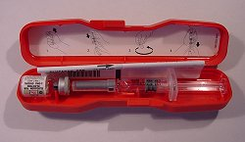
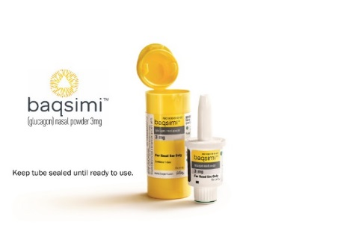
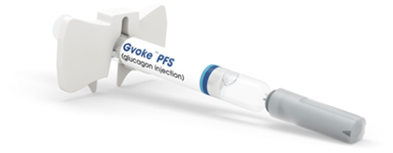
Treating Lows: Unresponsive Patient
Use with severe hypoglycemia:
Unconscious/Unresponsive
Unable to swallow/Risk of choking
glucagon (GlucaGen) Emergency Injection Kit
Intramuscular (IM) injection; needs mixing
glucagon (Gvoke PFS) injection
Subcutaneous; Premixed kit
3) glucagon (Baqsimi) nasal powder
nasal inhaled powder

Slide 13
Glucagon Rescue Agent
If patient is unconscious or seizing, assume blood sugar is low
Glucose gels are OK as long as patient can swallow; never given to an unresponsive or seizing patient
Patient cannot be harmed by receiving Glucagon or too much Glucagon
Dose may be repeated once if slow to respond to first dose.
EMS should be called when Glucagon is given

Slide 14
After Giving Rescue Agent(s):
Call for emergency medical help right away.
If the person is unconscious turn the person on their side. Monitor for seizure activity.
Encourage the person to eat as soon as possible. When they are able to safely swallow, give the person a fast acting source of sugar, such as juice. Then encourage the person to eat a snack, such as crackers with cheese or peanut butter.
If the person does not respond after 15 minutes, another rescue agent dose may be given, if available.

Slide 15
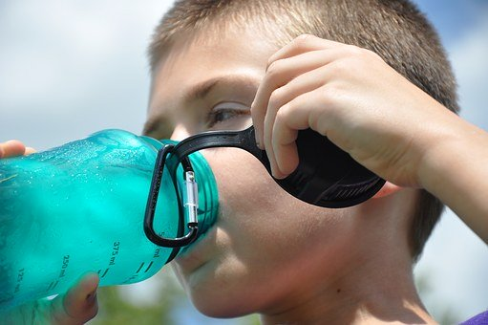
Hyperglycemia: High Blood Sugar
Increased urination
Increased thirst
Blurry vision
Tiredness, fatigue
Muscle aches
Abdominal
Legs
Flushed cheeks
Irritability
Headaches (ADA, 2020)

Slide 16
Causes of Hyperglycemia
Missed insulin injection
Miscalculation of insulin
Pump infusion set problem
“Wet shots” (pen devices)
Illness
Stress (emotional/pain)
** Treatment is (extra) insulin **

Slide 17
Food Sources that Affect Blood Glucose
Carbohydrates (starches, fruits, vegetables, milk, and sugars)
Constitutes most of the glucose that enters the bloodstream between 15 minutes to 2 hours after eating.
Protein and Fats
Glucose from protein and fat appears hours after eating, not immediately after the meal; proteins and fats can potentially slow down the rate at which accompanying carbohydrates turn to glucose.
Note: High fat meals may extend postprandial glycemia
(ADA, 2020; Bell, 2020)

Slide 18
Therapeutic Interventions: Insulin Types & Regimens

Slide 19
Why is insulin so important?
Through digestion, food is broken down into a simple sugar called glucose which enters the bloodstream.
The pancreas releases insulin (a hormone) into the blood which helps the glucose enter the cells for use as energy.
Without enough insulin, glucose cannot leave the bloodstream to get into the body’s cells; thus, levels of glucose in the blood are increased (hyperglycemia).
Hyperglycemia is the defining feature of T1D.

Slide 20
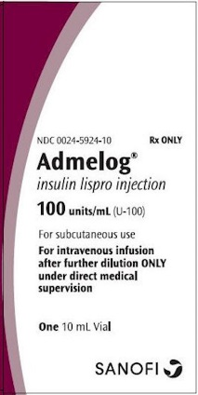
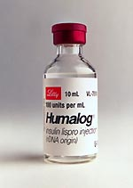
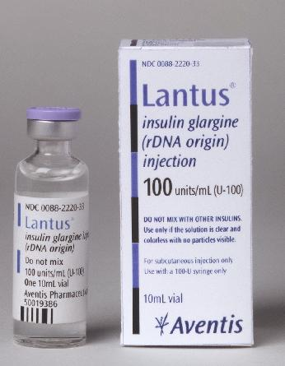
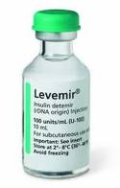
Insulin Categories
Rapid or fast-acting analog (Bolus)
lispro (Humalog, Admelog)
aspart (Novolog, Fiasp)
glulisine (Apidra)
Intermediate-acting
NPH (rarely used today)
Long-acting (Basal)
glargine (Lantus, Basaglar, Toujeo)
detemir (Levemir)
degludec (Tresiba)

Slide 21
Insulin Types
Insulin Type | Onset | Peak | Duration
NPH | 1-2 hrs. | 4-6 hrs. | 4-18 hrs.
aspart (Novolog) | 15 mins | 30 mins- 3 hrs. | 3-5 hrs.
lispro (Admelog, Humalog) | 15 mins | 30 mins- 3 hrs. | 3-5 hrs.
aspart (Fiasp) | 15-20 mins. | 1.5-2 hrs. | 5-7 hrs.
glulisine (Apidra) | 15 mins. | 30 mins-3 hrs. | 3-5 hrs.
glargine (Lantus/Basaglar) | 1 hr. | none | 24 hrs.
detemir (Levemir) | 1-2 hrs. | 6-8 hrs. | 16-24 hrs.

Slide 22
Insulin Action Diagram

Slide 23
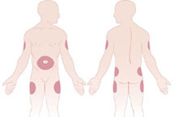
Injection Site Selection
Inject into subcutaneous fatty tissues
Backs of the arms, buttocks, thighs and abdomen
Rotate side to side or in a M or W rotation

Slide 24
Insulin Storage (pens and vials)
Insulin is viable for 28 days once opened and/or stored at room temperature (there are exceptions i.e. detemir)
Once open insulin can be kept at room temperature
Do not expose to freezing or direct sunlight
Unopened insulin should be stored in refrigerator until expiration date on box
In school age children a separate insulin supply should be kept at school. It should not transported back and forth between home and school.

Slide 25
Insulin Regimens
Regimen | Advantages | Disadvantages
Intermediate Acting
(NPH + Rapid Acting) | Can be mixed together 2-3 injections (no noontime) Routine schedule of meals, injections, activity Cost effective | Increased possibility of hypoglycemia Must be a consistent eater Limited flexibility with mealtimes and amounts eaten
Multiple Daily Injections (MDI)
Intensive management/Flexible Long-+ Rapid-acting | Improved linear growth in peds Improved glycemic control Flexible schedule | Multiple injections (4-6x/day) Must carbohydrate count Long acting cannot be mixed with other insulins

Slide 26
Insulin Therapy
Multiple Daily Injections (MDI):
Sliding Scale vs Basal Bolus Therapies

Slide 27
Sliding Scales
Precalculated dose of (rapid-acting) insulin is given before each meal (B,L,D)
Increases in amount with increasing blood sugars
Must use fixed amount of carbs at each meal Sample Scale
Does not include insulin coverage with snacks
Snacks are typically very low carbohydrate (< 5-10 g of carb)
Used in patients with:
Limited education/teachability (math skills)
Newly diagnosed patients
Consistent eaters
BG | Insulin unit
<80 | _ units
81-150 | _ units
151-250 | _ units
251-350 | _ units
>350 | _ units

Slide 28
MDI using Basal Bolus Therapy
Basal Insulin: (long acting: glargine/detemir/degludec)
Long Acting insulin (same dose given once daily usually at bedtime)
Controls fasting blood glucose levels
Equals approximately half of your total daily amount of insulin
dose given is not dependent on your BG values each day
Bolus Insulin: (rapid acting: aspart/glulisine/lispro)
Dose calculated based on carb content of meal and pre meal BG value (if above target)
Given pre meal ideally
Higher amount of carbs eaten at meal=higher amount of insulin taken
Higher BG before meal=higher amount of insulin taken for meal

Slide 29
CSII Devices:
How to care for patients on CSII therapy
Disclaimer: this is not a comprehensive list of device technologies available in the US. The slides should not take the place of formal education delivered by each commercial company or for promotional purposes.

Slide 30
Technology Currently Available in the US
Continuous Subcutaneous Insulin Infusion (CSII) Options:
Medtronic 630G, 670G
Tandem Tslim X2
Insulet Omnipod, Omnipod DASH
Continuous Glucose Monitor (CGM) Stand Alone Options:
Medtronic Guardian Connect
Dexcom G4, G5, G6
Senseonics Eversense (implantable; longer term wear)
Freestyle Libre 14 day wear (flash monitor; not continuous)
Note: For the purposes of this activity we will be discussing a subset of CSII and CGM as they are most commonly used in the treatment of T1DM in the US and represent the most current technology available at the time of the recording.

Slide 31
CSII Therapy
CSII (pump therapy) is continuous infusion of rapid-acting insulin via a pump device
Each pre-set hourly rate is called a “Basal Rate”
More than one basal rate may be needed during 24 hours for optimal diabetes control
Rates can adjusted up or down as needed based on BG patterns or on a temporary basis for illness and activity
Sample Basal 12a-3a 0.65
Rate Pattern: 3a-8p 0.55
8p-12a 0.65

Slide 32
CSII Therapy
Bolus is an amount of insulin given at one time based on carb content of meal and pre meal BG value (if above target) similar MDI therapy
Given before meal is consumed ideally
Dose calculated by pump with preprogrammed settings
Extended bolus: Insulin amount can be slowed down to better match certain food groups (high fat content foods)

Slide 33
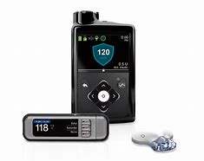
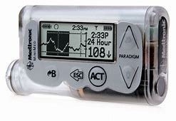
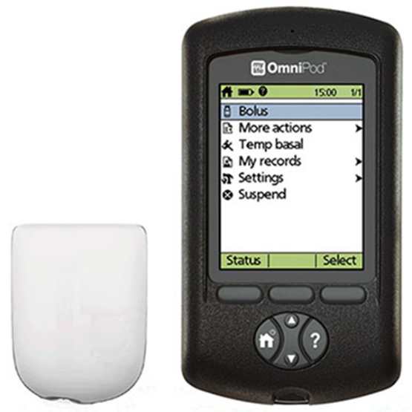
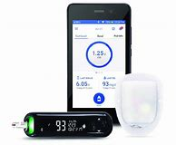
Insulin Pump Devices - CSII
Disclaimer: this is not a comprehensive list of device technologies available in the US. The slides should not take the place of formal education delivered by each commercial company or for promotional purposes.

Slide 34
Benefits of CSII
Better blood sugar control
Less hypoglycemia (low blood sugar)
Patients on the pump may be able to lower their HgbA1c with less risk of hypoglycemia than patients on multiple daily injections.
Greater flexibility with eating, meal schedules and exercise activity

Slide 35
How does it work?
The pump delivers small amounts of rapid-acting insulin (aspart/lispro/glulisine) through a tiny flexible tube inserted under the skin.
Because only rapid-acting insulin is used, results of a dose change can be seen quickly.
Insulin doses can be matched more precisely to meet the body’s needs.
Pump site locations are the same as where injections are given (subcutaneous fat) and are changed every 2-3 days (type of insertion set dependent).

Slide 36
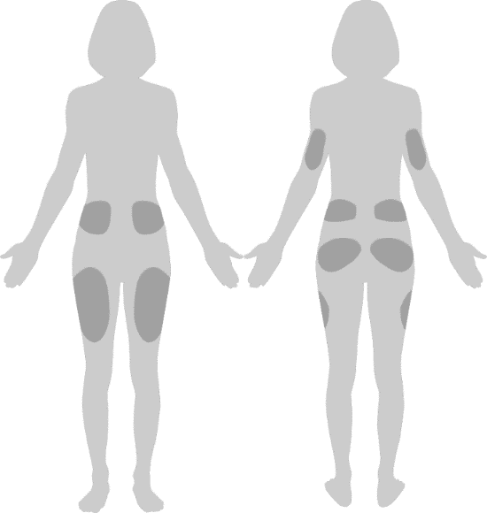
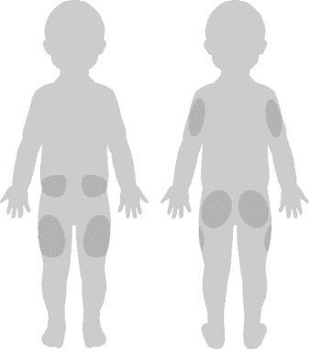
Site Selection and Application
Front
Back
Rotate infusion sites with each change
A new site should be at least 1 inch away from the previous site
Do not apply within 2 inches of your navel or over a mole, scar, tattoo or where it will be affected by folds of skin
Front
Back

Slide 37
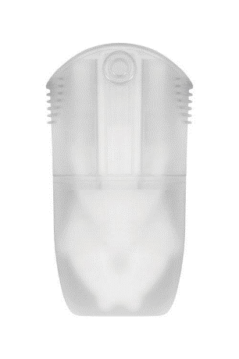
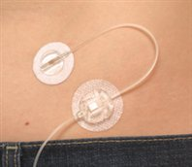
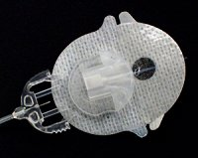
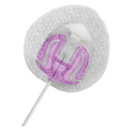
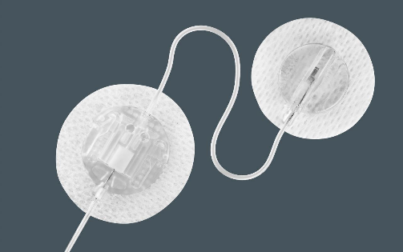
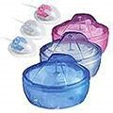
Insertion Sets
Angled 30-40-degree insertion
2 day Straight 90 degree insertion
Straight 90-degree insertion
Disclaimer: this is not a comprehensive list of device technologies available in the US. The slides should not take the place of formal education delivered by each commercial company or for promotional purposes.

Slide 38
Integrated CSII
and
Continuous Glucose Monitoring Devices
Disclaimer: this is not a comprehensive list of device technologies available in the US. The slides should not take the place of formal education delivered by each commercial company or for promotional purposes.

Slide 39
Medtronic 670G System
https://www.medtronicdiabetes.com/home

Slide 40
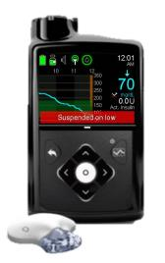
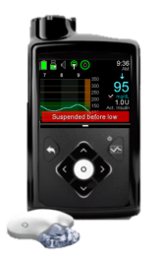
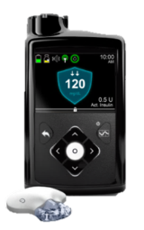
Medtronic 670G System
SmartGuard™ hcl technology
Increasing levels of automation to best fit your diabetes management needs.
.
Suspends insulin delivery when glucose levels reach a pre-set low limit providing greater protection against lows*¹
Suspend before low
Suspends insulin delivery before glucose levels reach a pre-set low and resumes delivery when levels recover to help you further address lows.
Auto Mode
Automatically adjusts basal insulin delivery based on sensor glucose readings to help you stay within your target glucose range.

Slide 41
Tandem Tslim X2
https://www.tandemdiabetes.com/

Slide 42
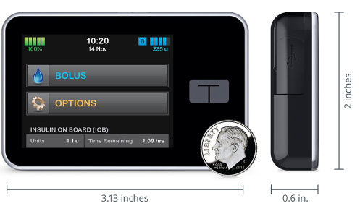
Tandem Tslim X2
Remote software updates to existing pump
Touch screen
Waterproof (ipx 7 approval)
Rechargeable with micro SB port
Customizable settings
Multiple basal, ICR, ISF, and target profiles which are helpful for menses
Works with Dexcom G4, G5 or G6 CGM depending on pump software
Holds up to 300 units of insulin
Smaller design

Slide 43
Tandem Tslim X2 (Software Differences)
Basal IQ (released in July 2018)
helps reduce the frequency and duration of low-glucose events by predicting glucose levels 30 minutes ahead and suspending insulin if they are expected to drop below 80 mg/dL using Dexcom G6 CGM values. Insulin delivery resumes as soon as sensor glucose values begin to rise.
Control IQ (released in December 2019)
designed to help increase time in range (70-180 mg/dL) using Dexcom G6 CGM values to predict glucose levels 30 minutes ahead and adjust insulin delivery accordingly.
Automatic insulin adjustments
Automatic correction boluses
Activity settings (sleep & exercise

Slide 44
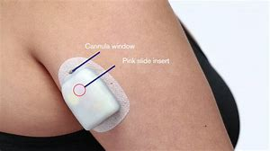
Omnipod (tubeless pump system)
https://www.myomnipod.com/healthcareproviders/about-omnipod/DASH

Slide 45
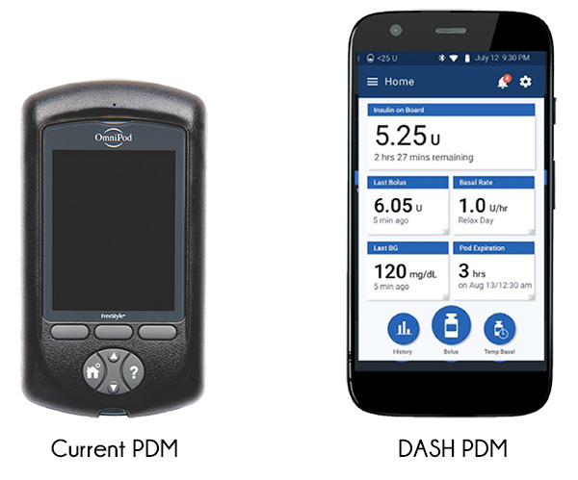
Omnipod (tubeless pump system)

Slide 46
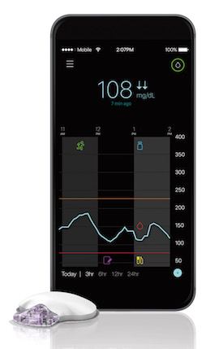
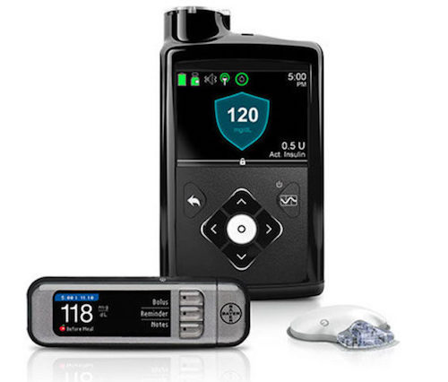
Continuous Glucose Monitoring Systems
Dexcom G6
(stand alone CGM)
Medtronic 670G with Guardian Connect
Guardian 3 CGM (stand alone CGM)
(integrated pump & CGM)
https://www.dexcom.com/get-started-cgm
Disclaimer: this is not a comprehensive list of device technologies available in the US. The slides should not take the place of formal education delivered by each commercial company or for promotional purposes.

Slide 47
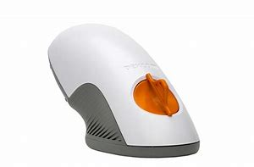
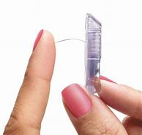
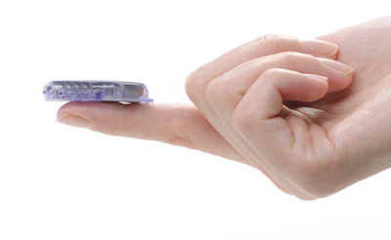
Dexcom G6 CGM
Zero finger sticks (FDA approved)
Customizable Alerts & Alarms (alerts for high and low BGs)
Smart Device compatibility
Easy insertion (one button push)
Share your data (patients and parents and caregivers;
up to 10 followers)
Indicated for ages 2 years and up
Ability to dose insulin off of CGM readings (FDA approved)
Can be used with MDI therapy or integrated with
Tandem Tslim X2 and Omnipod DASH pumps

Slide 48
Interdisciplinary Team Members
PCP Registered Nurse
Endocrinologist Registered Dietitian
Ophthalmologist Certified Diabetes Educator
Podiatrist Mental Health Professional
Dentist Fitness Professional
Pharmacist
(American Diabetes Association (2020)

Slide 49
References
Bell K., & Fio S. (2020). Amount and Type of Dietary Fat, Postprandial Glycemia, and Insulin Requirements in Type 1 Diabetes: A Randomized Within-Subject Trial.Diabetes Care, 43 (1), 59-66; DOI: 10.2337/dc19-0687
Children and Adolescents: Standards of Medical Care in Diabetes—2019. Diabetes Care. 42(1): S148-S164. https://doi.org/10.2337/dc19-S013
Evert A. B. (2014). Treatment of Mild Hypoglycemia. Diabetes spectrum : a publication of the American Diabetes Association, 27(1), 58–62. https://doi.org/10.2337/diaspect.27.1.58
Garber A., Grunberger G et al. (2020) Consensus Statement By The American Association of Clinical Endocrinologists and American College of Endocrinology On The Comprehensive Type 2 Management Algorithm-2020 Executive Summary. Endocrine Practice. 26 (1), 107-133
Garber A., Grunberger G et al. (2020). Treatment of Type 1 Diabetes. American Association of Clinical Endocrinologists. Retrieved May 30,2020 from https://www.aace.com/disease-state-resources/diabetes/depth-information/treatment-type-1-diabetes
Hyperglycemia (High Blood Glucose), Medical Management. American Diabetes Association. Retrieved May 30, 2020 from https://www.diabetes.org/diabetes/medication-management/blood-glucose-testing-and-control/hyperglycemia

Slide 50
References
Hypoglycemia (Low Blood Glucose). Medical Management. American Diabetes Association. Retrieved May 30, 2020 from https://www.diabetes.org/diabetes/medication-management/blood-glucose-testing-and-control/hypoglycemia
Standards of Medical Care in Diabetes—2020 Abridged for Primary Care Providers. (2020). Clinical Diabetes, 38(1), 10–38. Retrieved from https://clinical.diabetesjournals.org/content/38/1/10
Standards of Medical Care in Diabetes-Glycemic Targets: Standards of Medical Care in Diabetes-(2019). Diabetes Care, 42(1), S61-70. Retrieved from https://doi.org/10.2337/dc19-S006

